Slide 1
comparison for distribution for each position in Basketball
Sherod Brooks
Senior Mathematics Capstone Project
Faculty Advisor: Dr. Seonguk Kim

Slide 2
AGENDA
Abstract
Project goals
Basketball Information
​Parameters
Process of Project
Mathematical Analysis
​Coding Work

Slide 3
Abstract
We used mathematical and data analysis through multiple applications to gain insights on what NBA teams can look for when they are deciding who they should draft, sign in free agency, etc. We used mathematical tools such as normal distribution to get those insights and we used pandas, excel, and other tools to visualize and explain our findings.

Slide 4
Project GOALS
Our primary goal is to find the distributions of FG, 3PT, 2PT, FT for each position

Slide 5
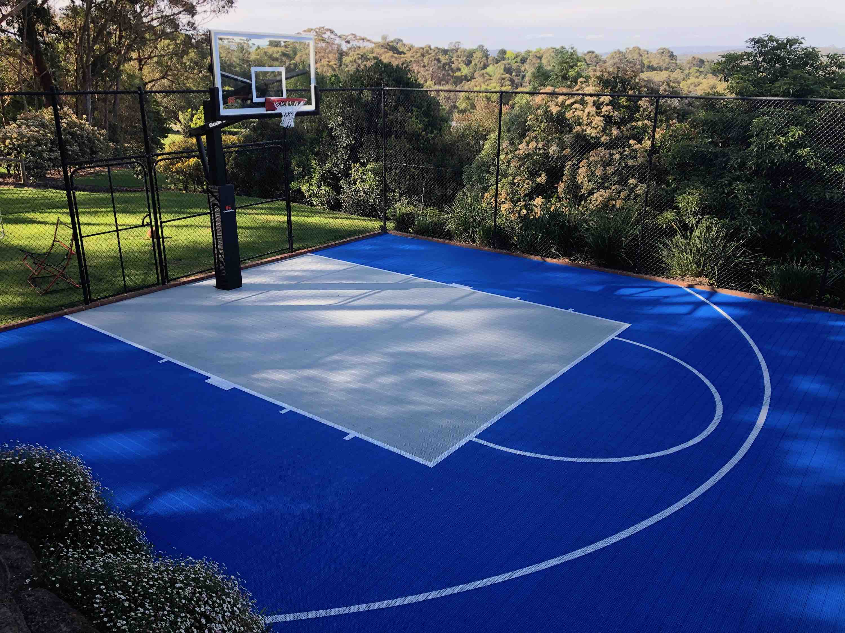
Basic basketball Info
National Basketball Association(NBA)
FG% , 3PT% , 2PT% , FT%

Slide 6
Parameters
NBA player stats from 1975-2017
Pre-historic 50s and 60s
Invention of the 3PT line and other rules

Slide 7
Process of the project
Data Analysis structure: collection, cleaning, analysis, visualization
First we got the data from Kaggle
Then put the data into Excel and cleaned and transform the data
With that new and cleaned data we put it into Pandas
Then lastly we put the data into Power Bi to get dynamic visualizations

Slide 8
Mathematical analysis
Normal Distribution Explained
A normal distribution, also known as the Gaussian distribution, is a probability distribution that is symmetric about the mean. It shows that data near the mean are more frequent in occurrence than data far from the mean. In graphical form, the normal distribution appears as a "bell curve". The normal distribution is used to analyze data when there is an equal chance for the data to be above and below the average value of the continuous data.

Slide 9
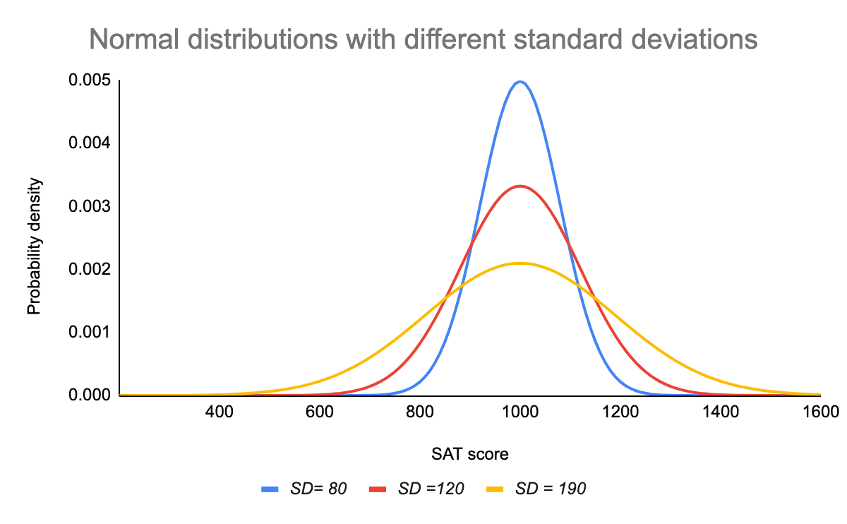
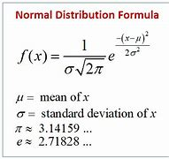
Standard Deviation: is a measure of variability. It defines the width of the normal distribution and determines how far away from the mean the values tend to fall
Mean(Average): the central tendency and defines the location of the peak of the bell curve, is also the median and mode.

Slide 10
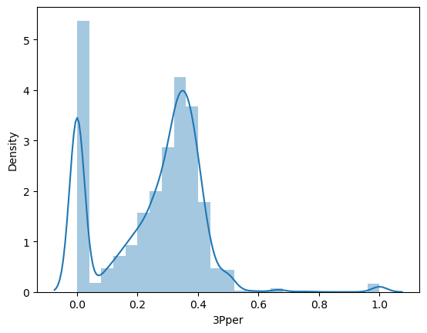
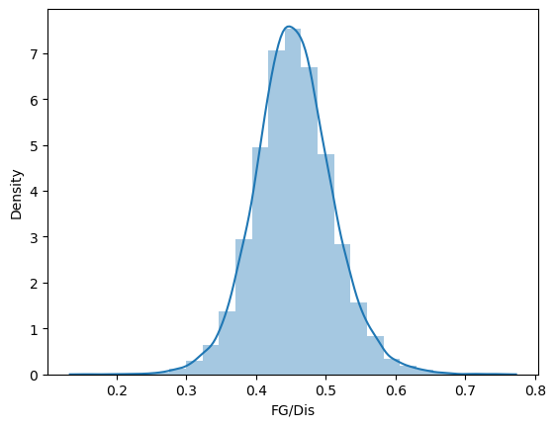
Mathematical analysis Cont.
Distributions by Position

Slide 11
Coding work
Kaggle: NBA Players stats since 1950 (kaggle.com)
Excel: (Original)Senior-Capstone-Project/Original_Season_data.xlsx at main · Sherodbrooks20/Senior-Capstone-Project (github.com), (Updated) Senior-Capstone-Project/seasons(updated).xlsx at main · Sherodbrooks20/Senior-Capstone-Project (github.com)
Pandas: Senior-Capstone-Project/Who_Should_NBA_Teams_Draft_Based_on_history_After_1975_clean (9).ipynb at main · Sherodbrooks20/Senior-Capstone-Project (github.com)

Slide 12
POWER BI DASHBOARD

Slide 13
Work Cited
“Swish Courts.” Swish Court, swishcourts.com.au/. Accessed 12 Apr. 2024.
Frost, Jim. “Normal Distribution in Statistics.” Statistics By Jim, 6 Oct. 2023, statisticsbyjim.com/basics/normal-distribution/.
Bhandari, Pritha. “Normal Distribution: Examples, Formulas, & Uses.” Scribbr, 21 June 2023, www.scribbr.com/statistics/normal-distribution/.
“Normal Distribution (Solutions, Examples, Formulas, Videos).” Www.Onlinemathlearning.Com, www.onlinemathlearning.com/normal-distribution.html. Accessed 12 Apr. 2024.

